Slide 1
3. Data Manipulation with pandas

Slide 2
Course Description
pandas is the world's most popular Python library, used for everything from data manipulation to data analysis. In this course, you'll learn how to manipulate DataFrames, as you extract, filter, and transform real-world datasets for analysis. Using pandas you’ll explore all the core data science concepts. Using real-world data, including Walmart sales figures and global temperature time series, you’ll learn how to import, clean, calculate statistics, and create visualizations—using pandas to add to the power of Python!

Slide 3
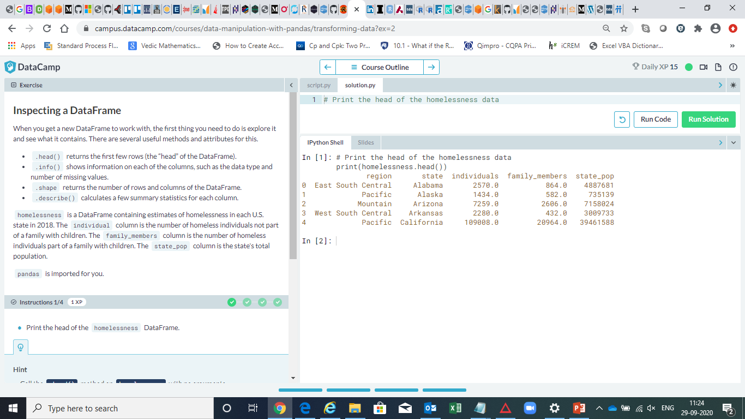

Slide 4
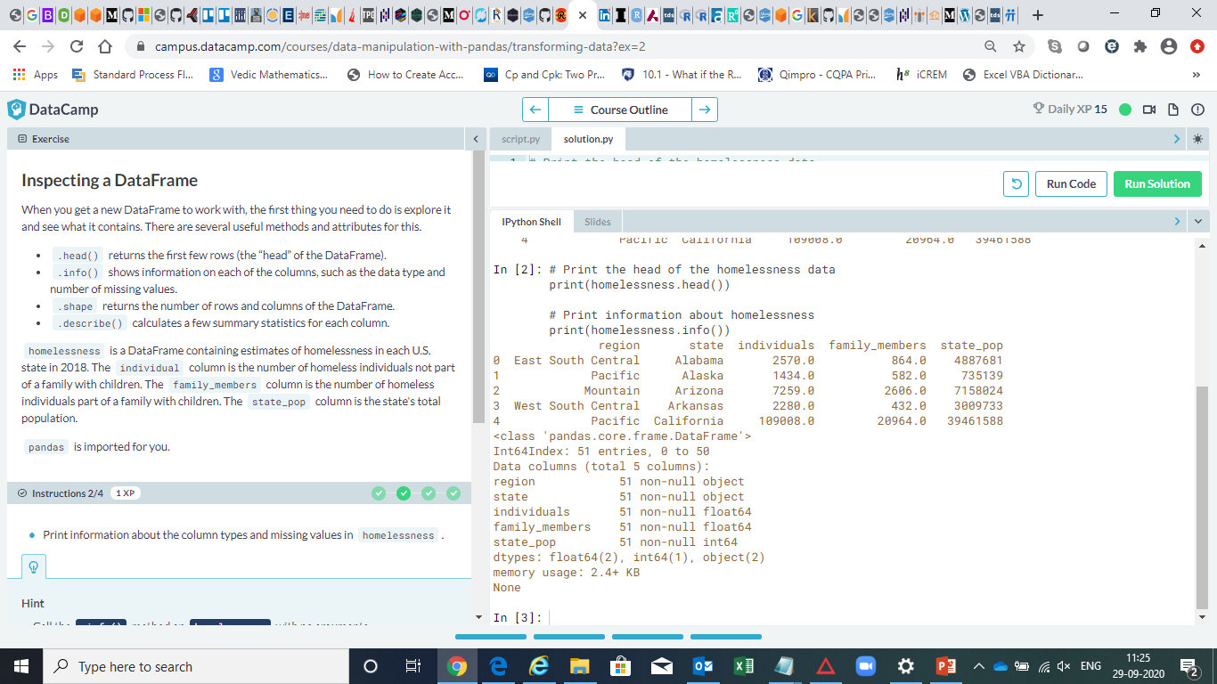

Slide 5
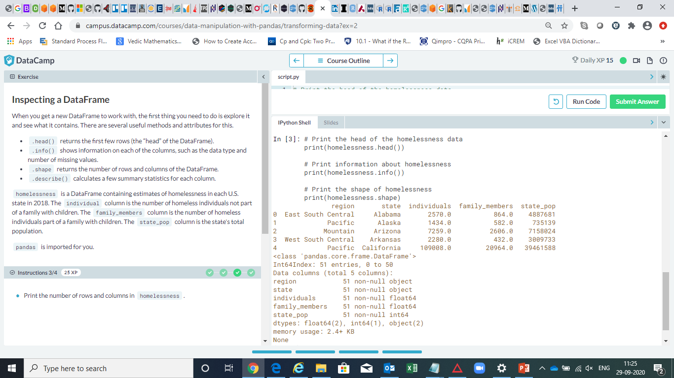

Slide 6
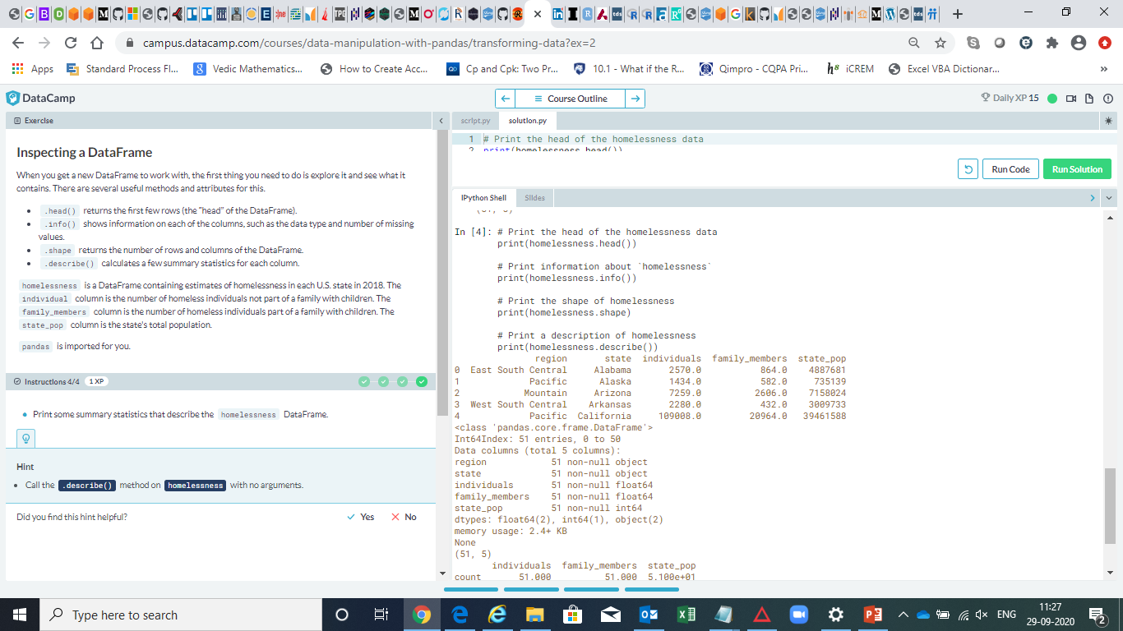

Slide 7
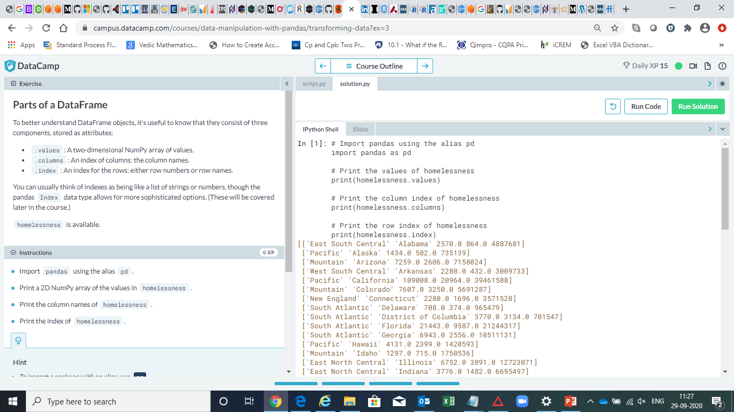

Slide 8
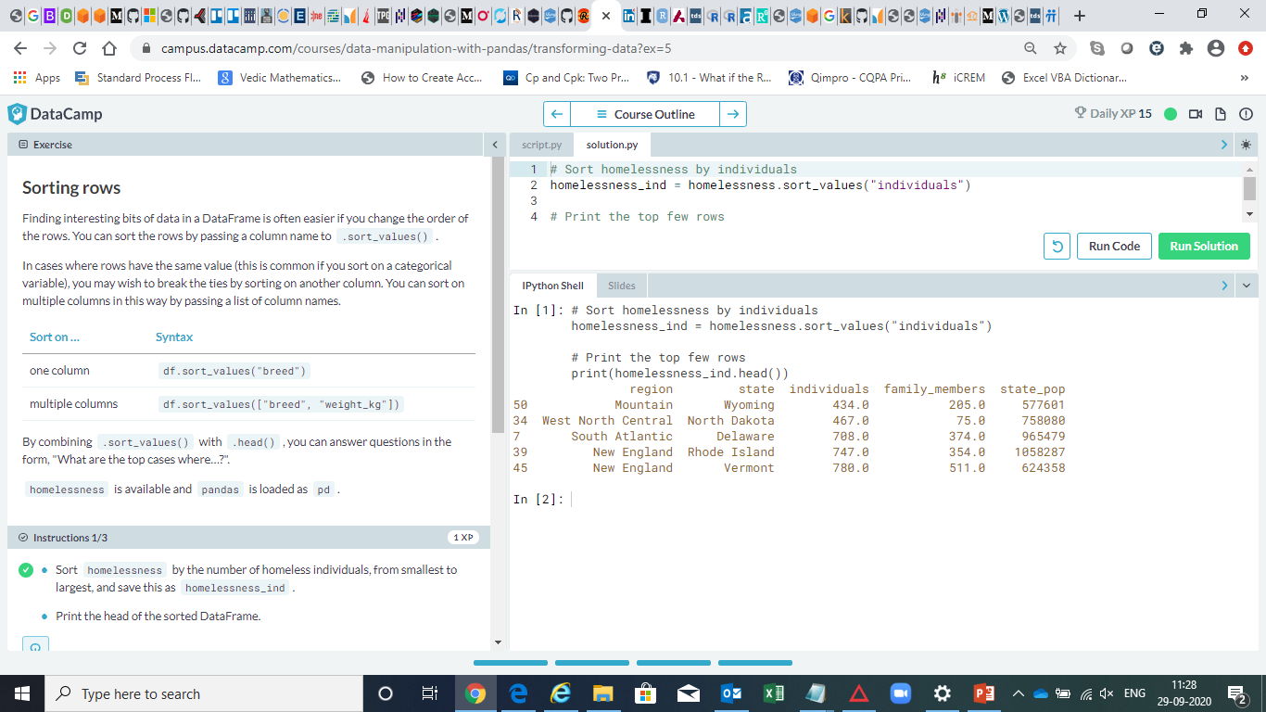

Slide 9
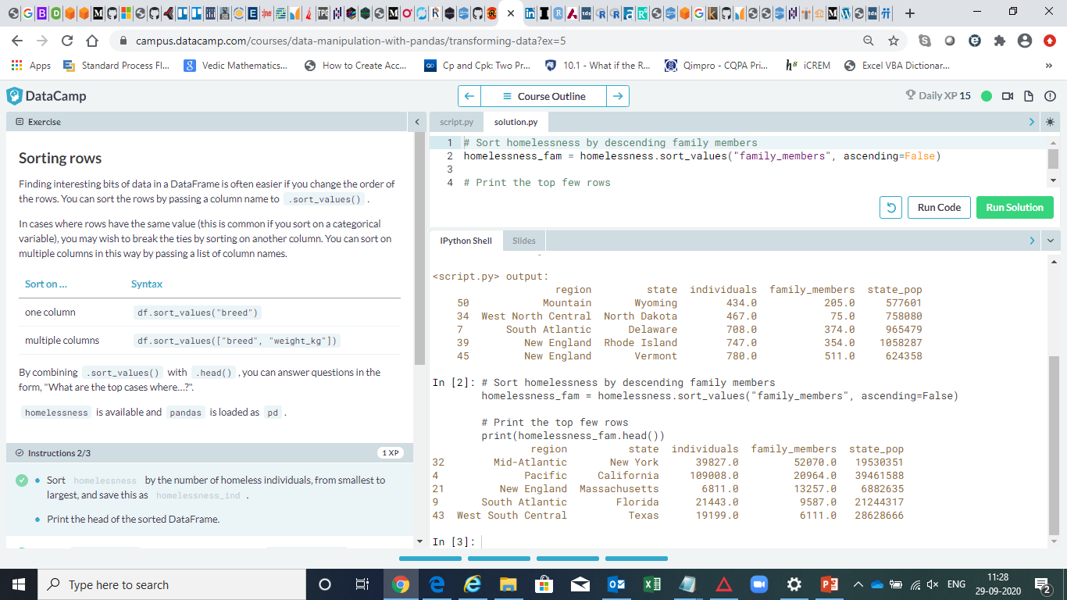

Slide 10
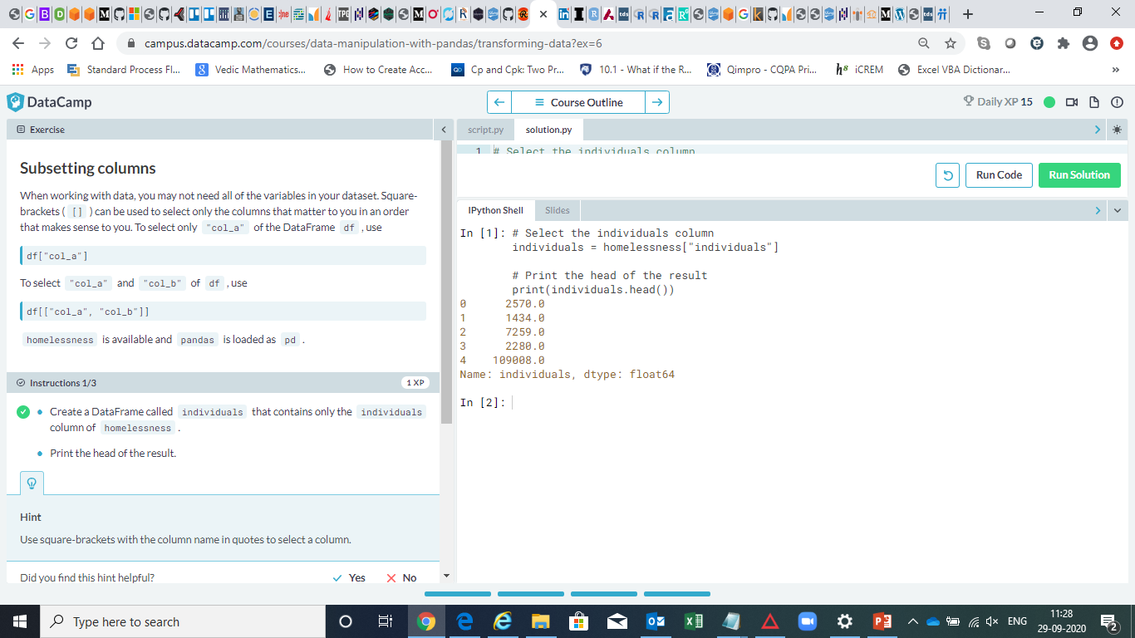

Slide 11
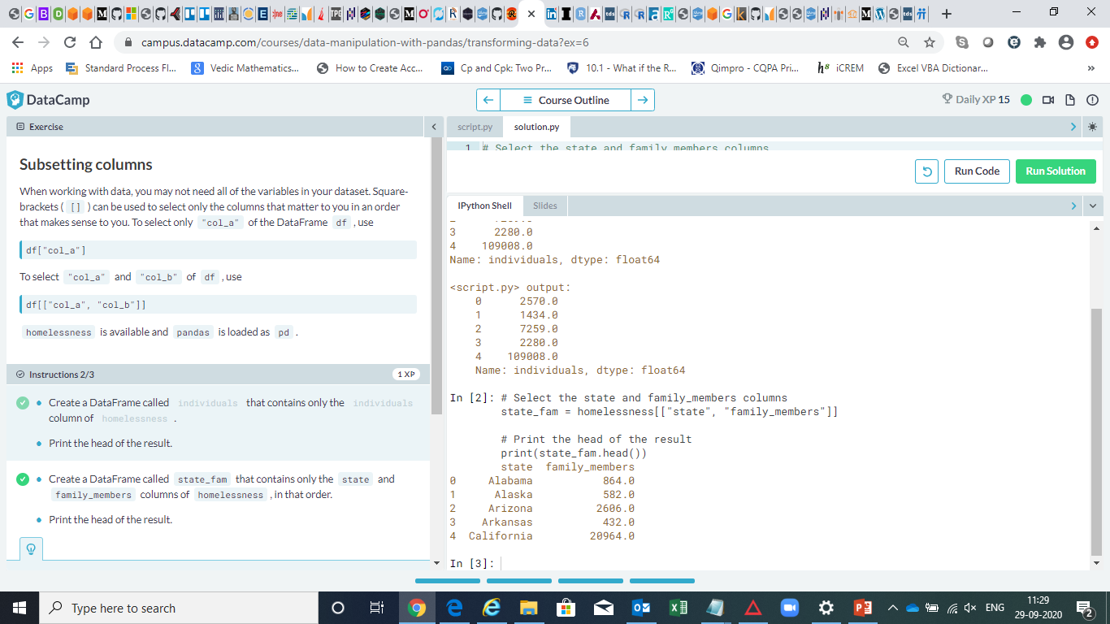

Slide 12
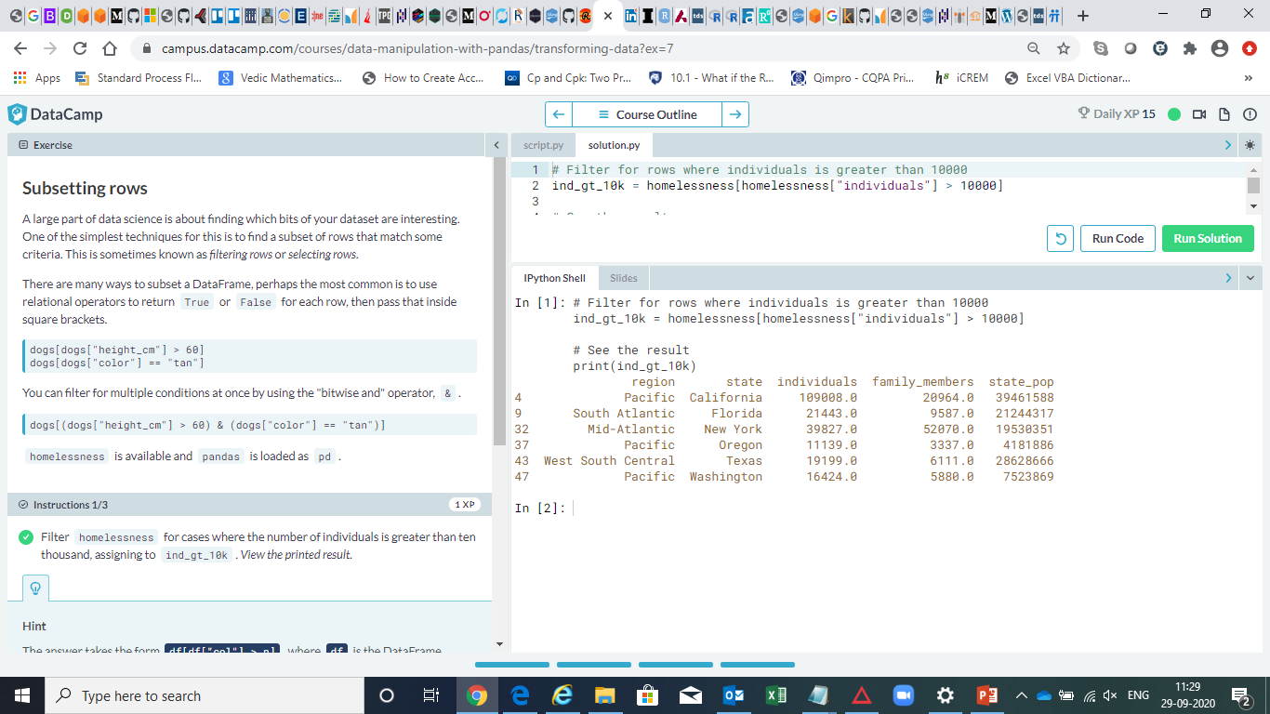

Slide 13
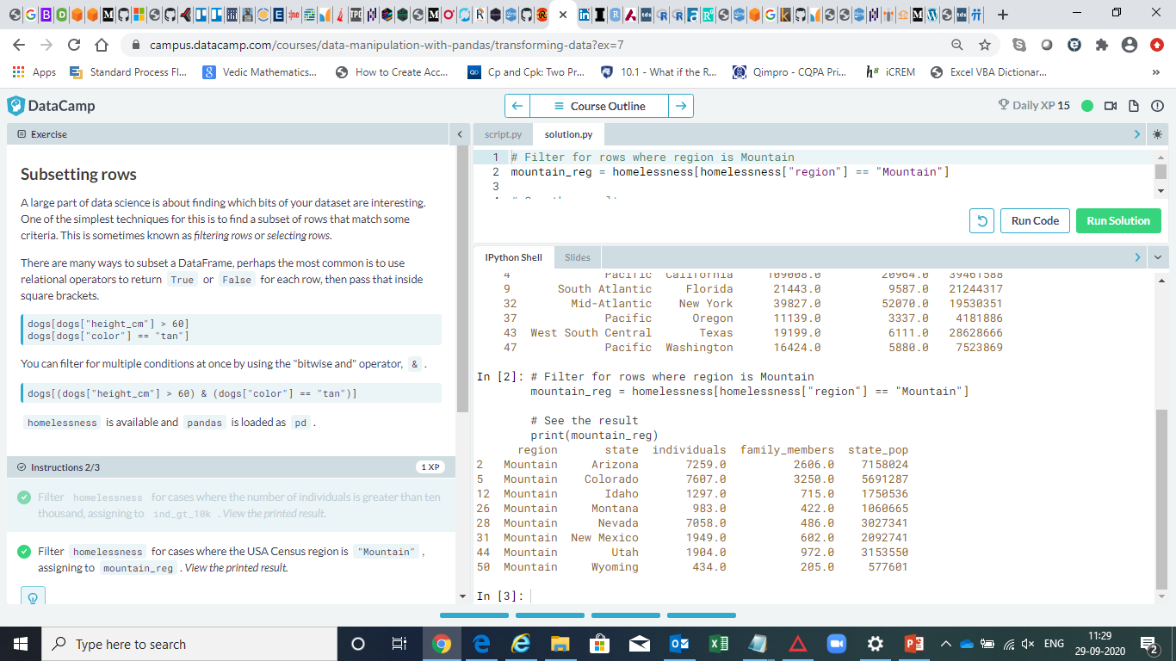

Slide 14
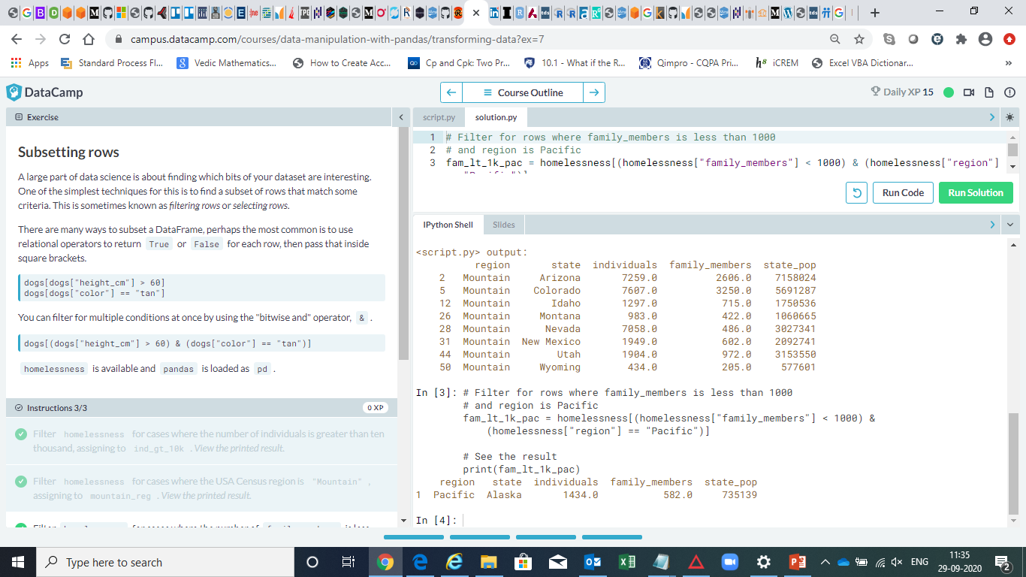

Slide 15
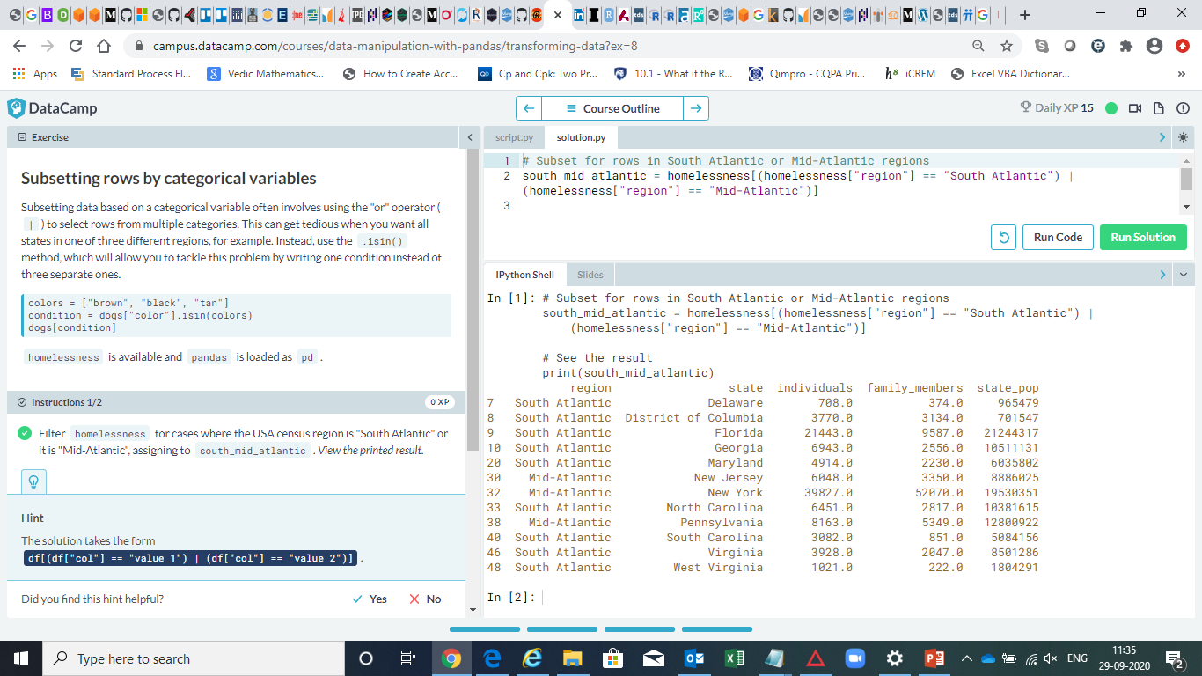

Slide 16
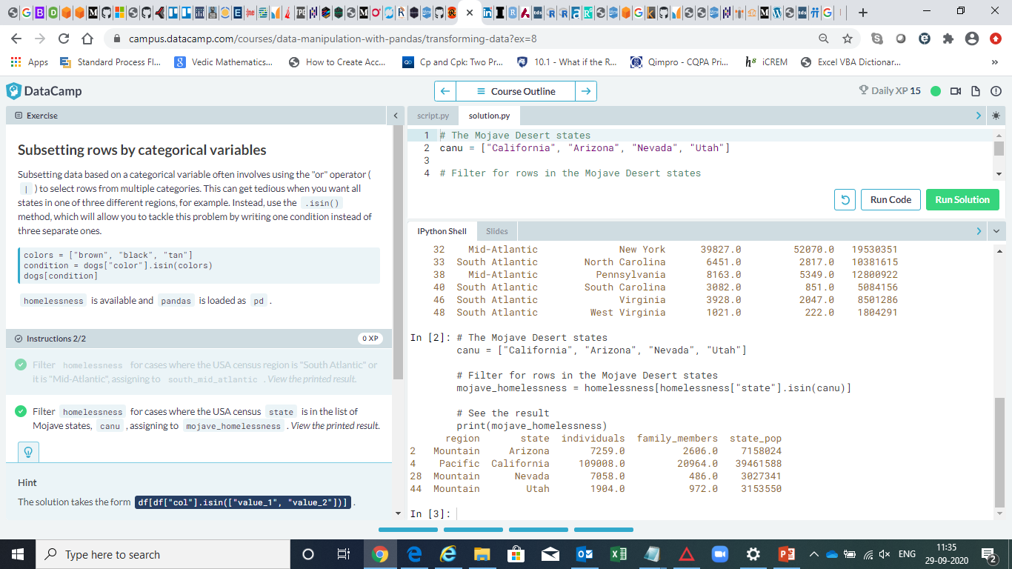

Slide 17
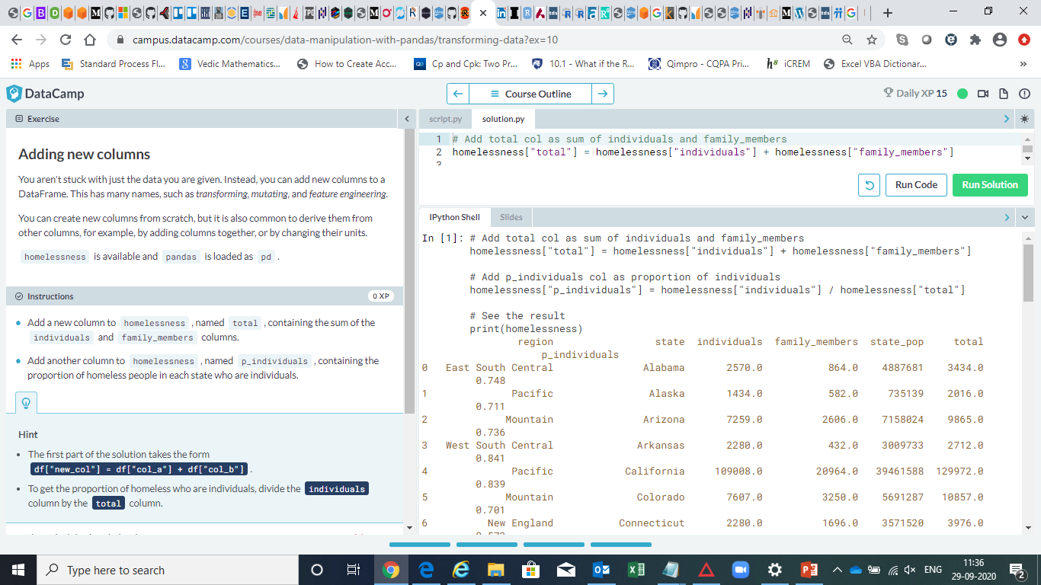

Slide 18
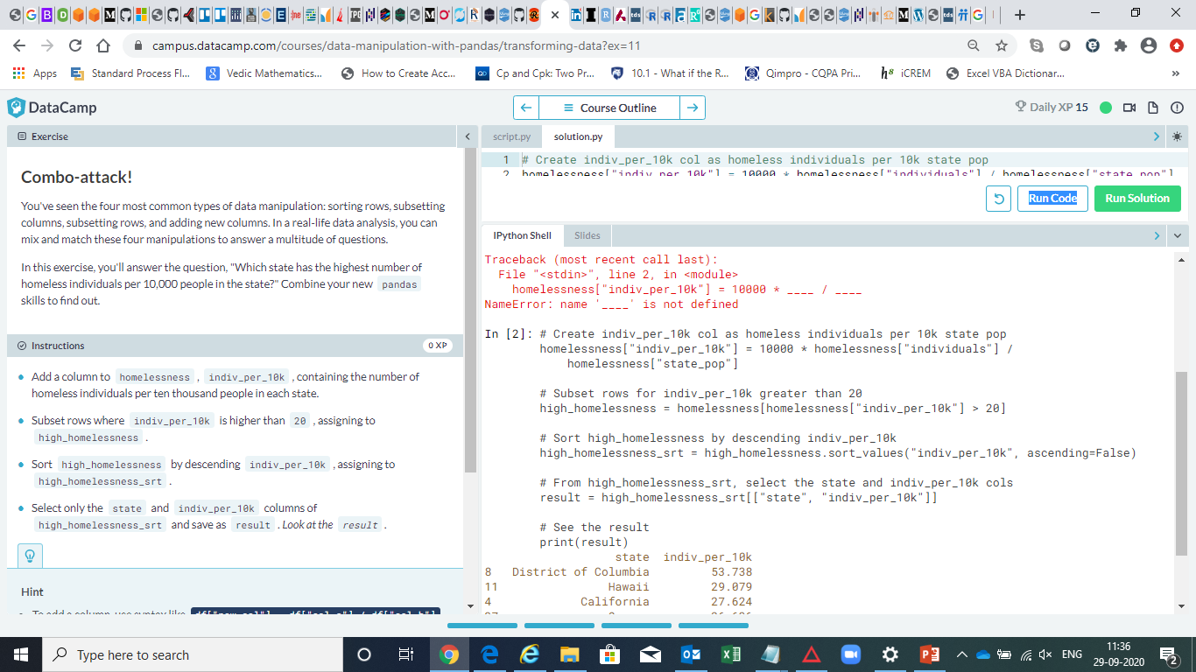

Slide 19
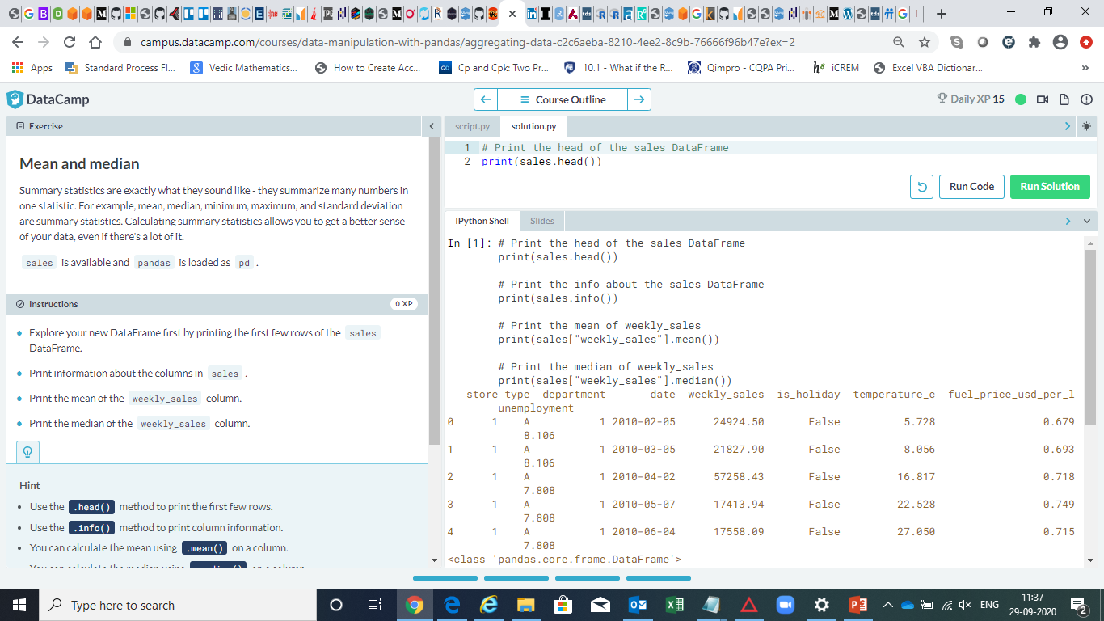

Slide 20
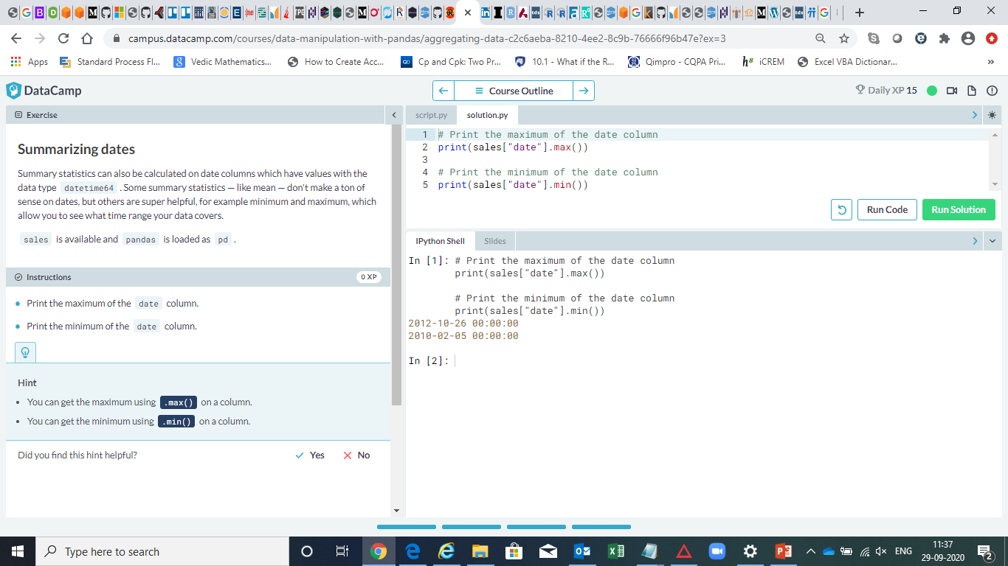

Slide 21
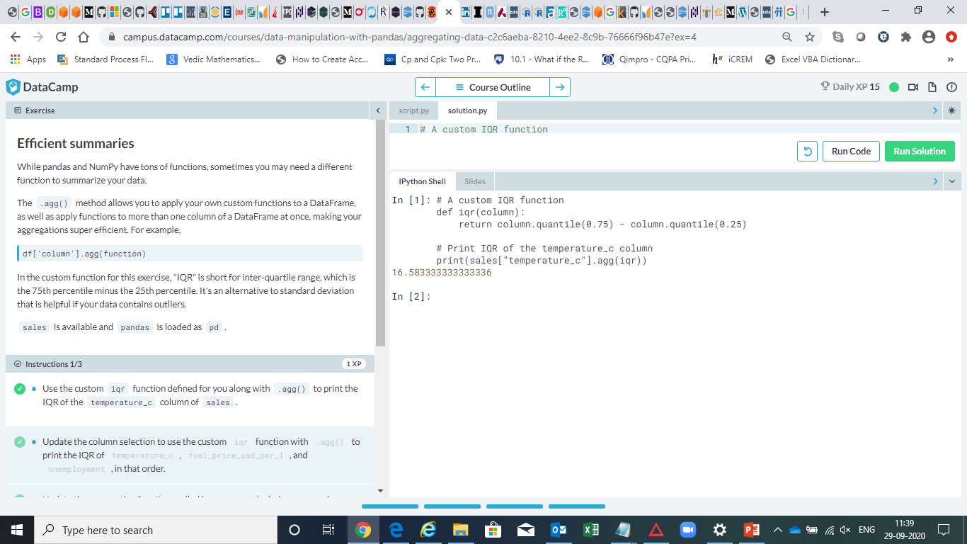

Slide 22
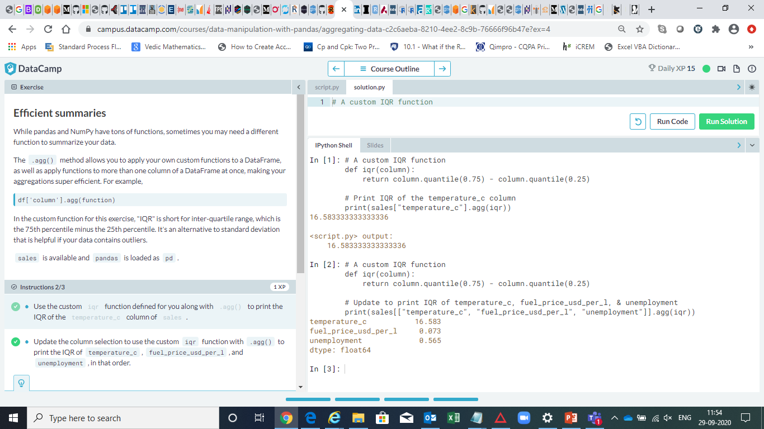

Slide 23
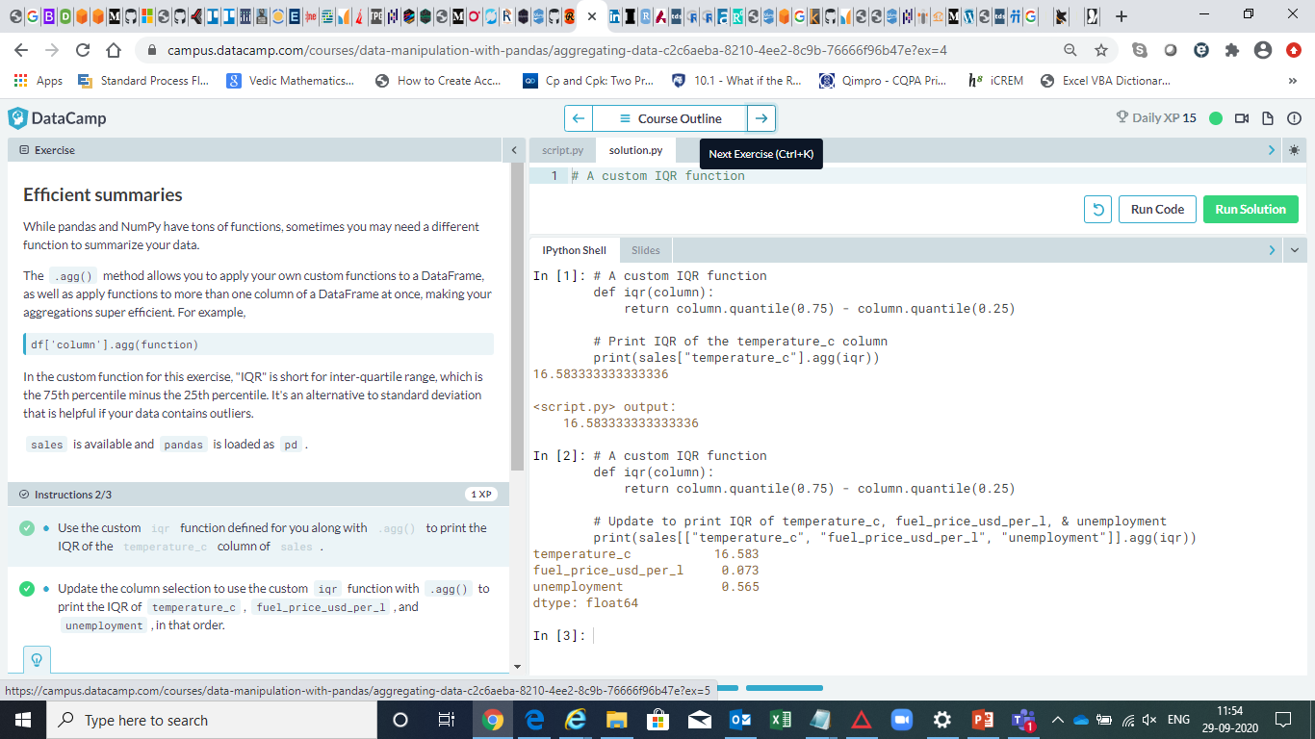

Slide 24
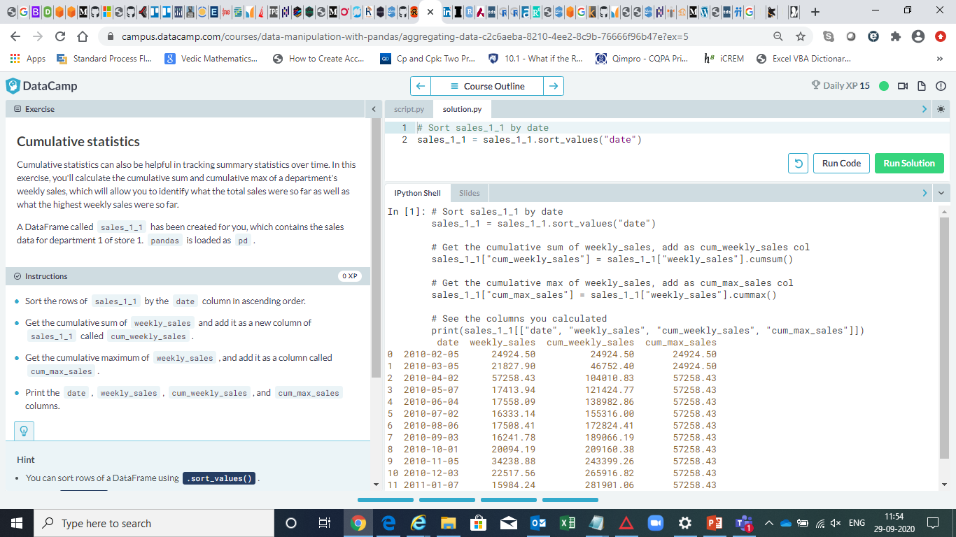

Slide 25
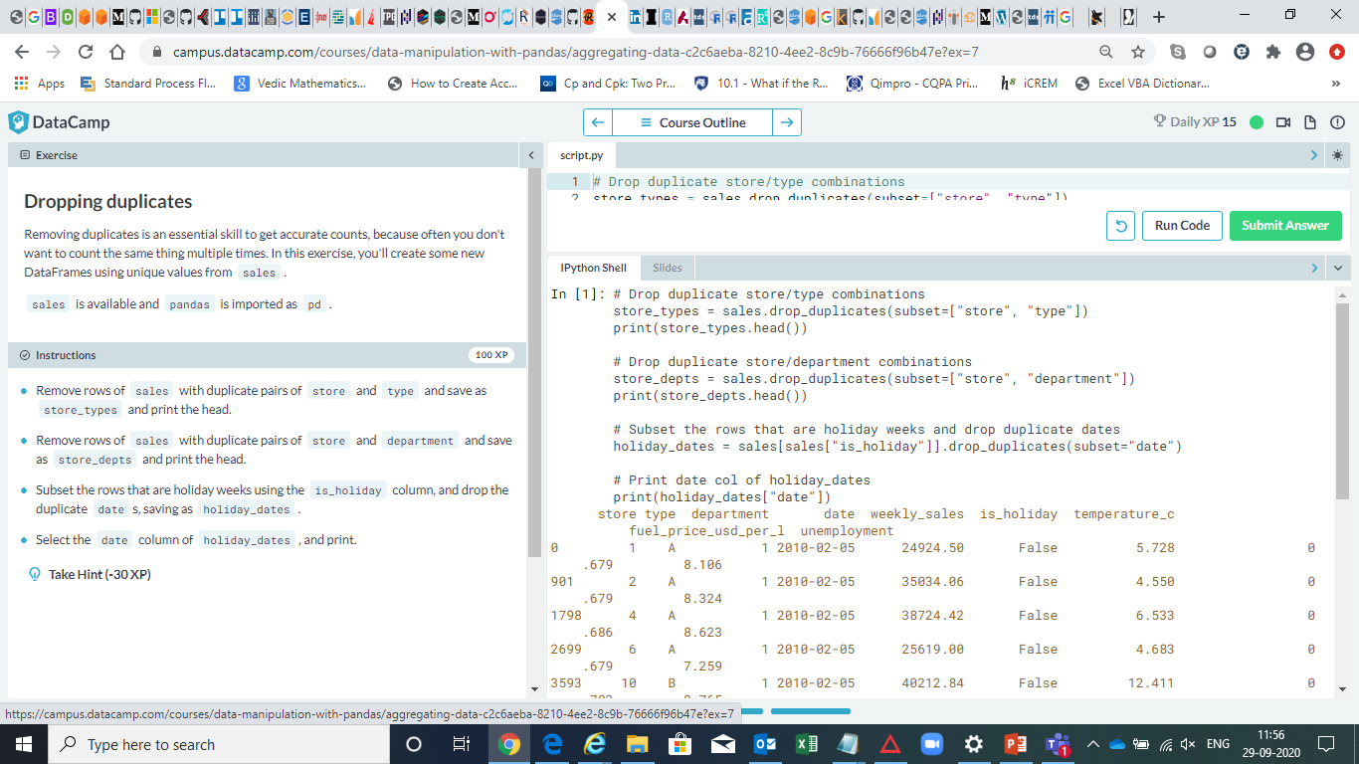

Slide 26
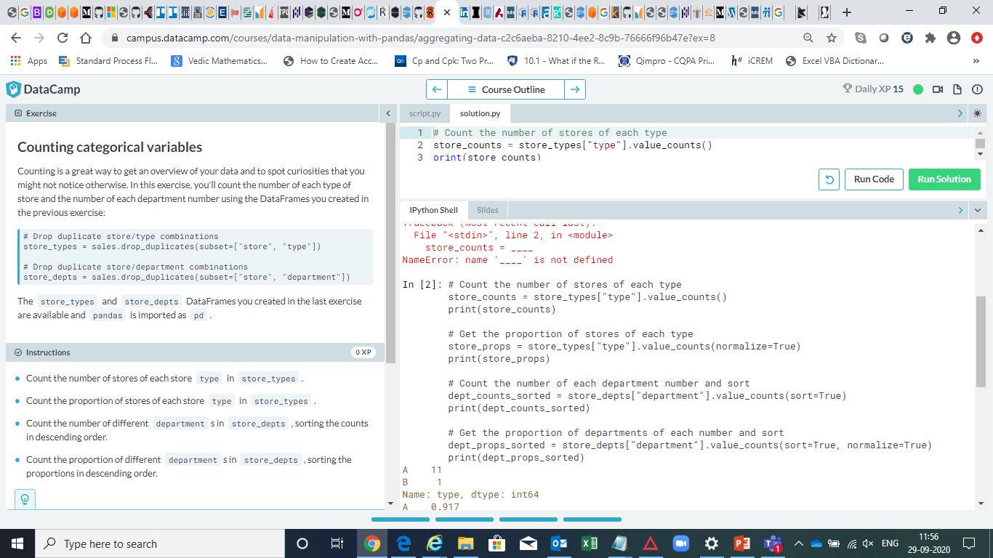

Slide 27


Slide 28


Slide 29
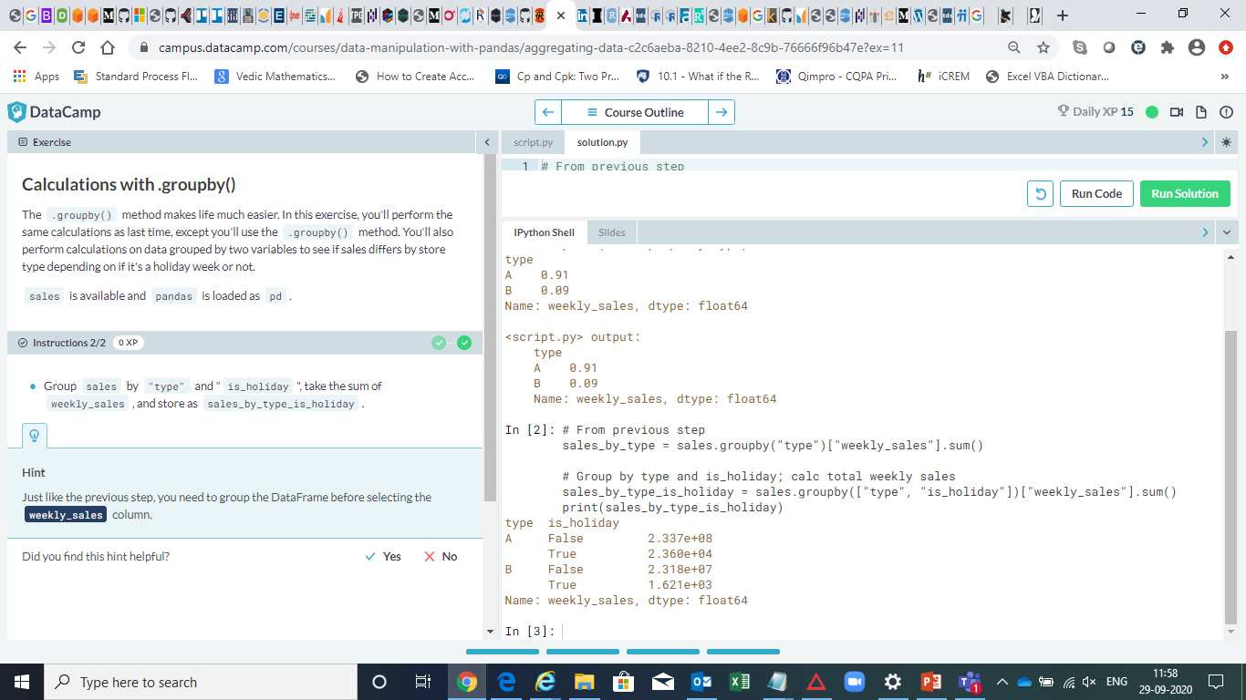

Slide 30
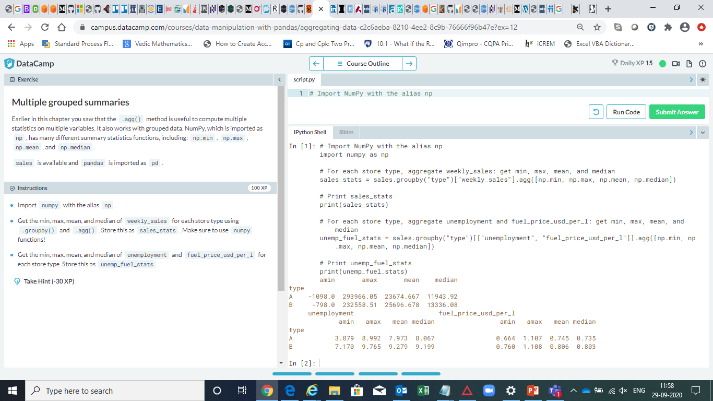

Slide 31
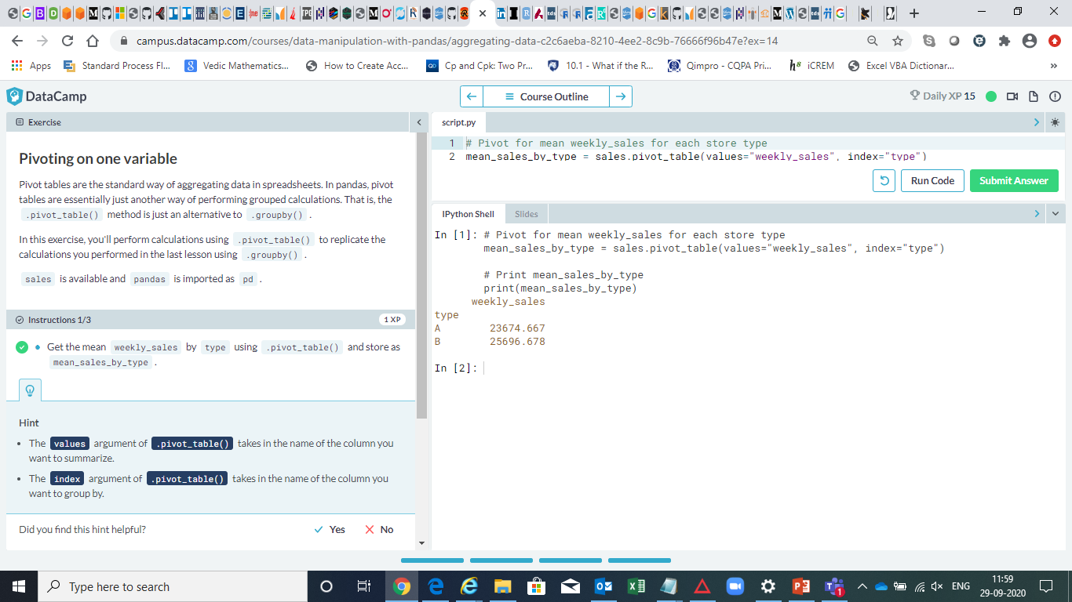

Slide 32


Slide 33
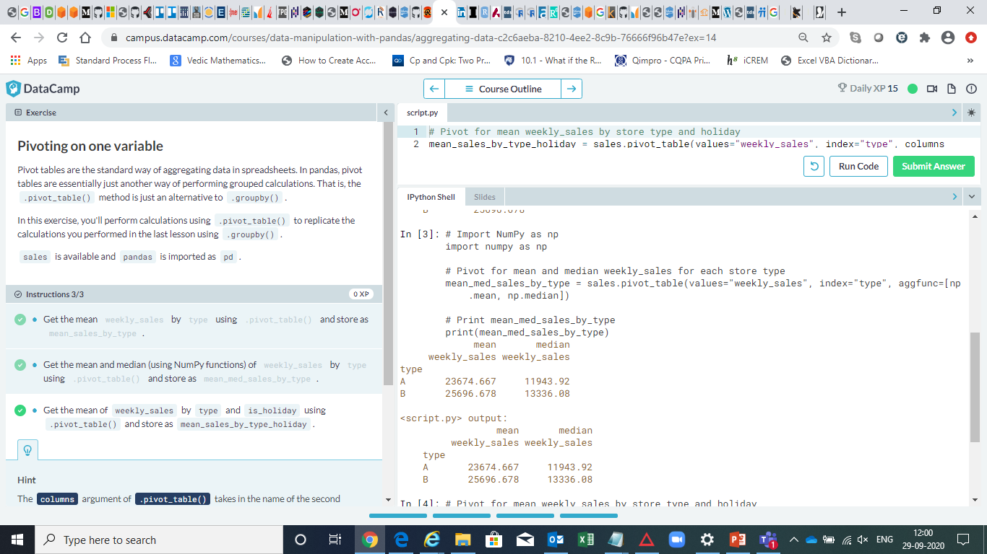

Slide 34
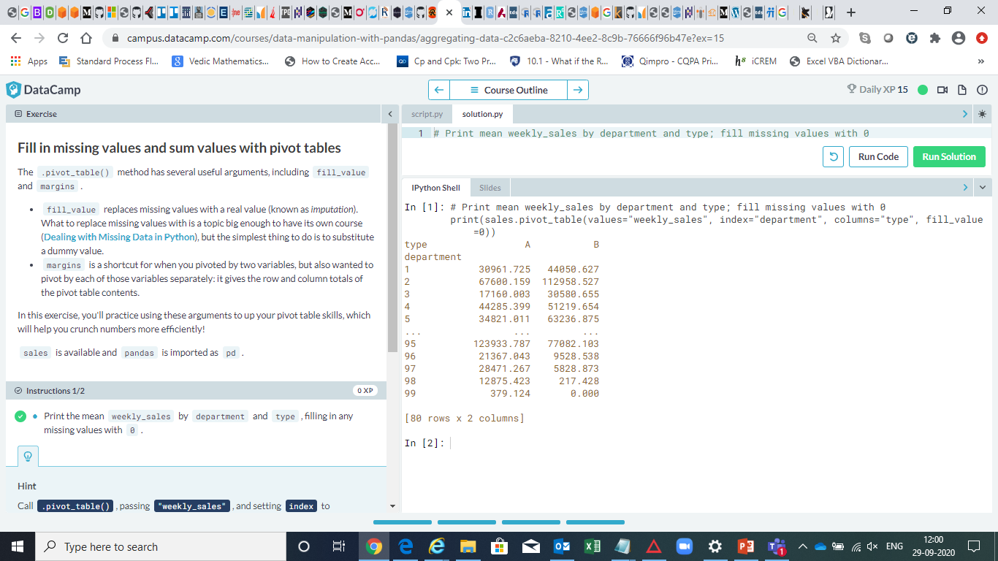

Slide 35
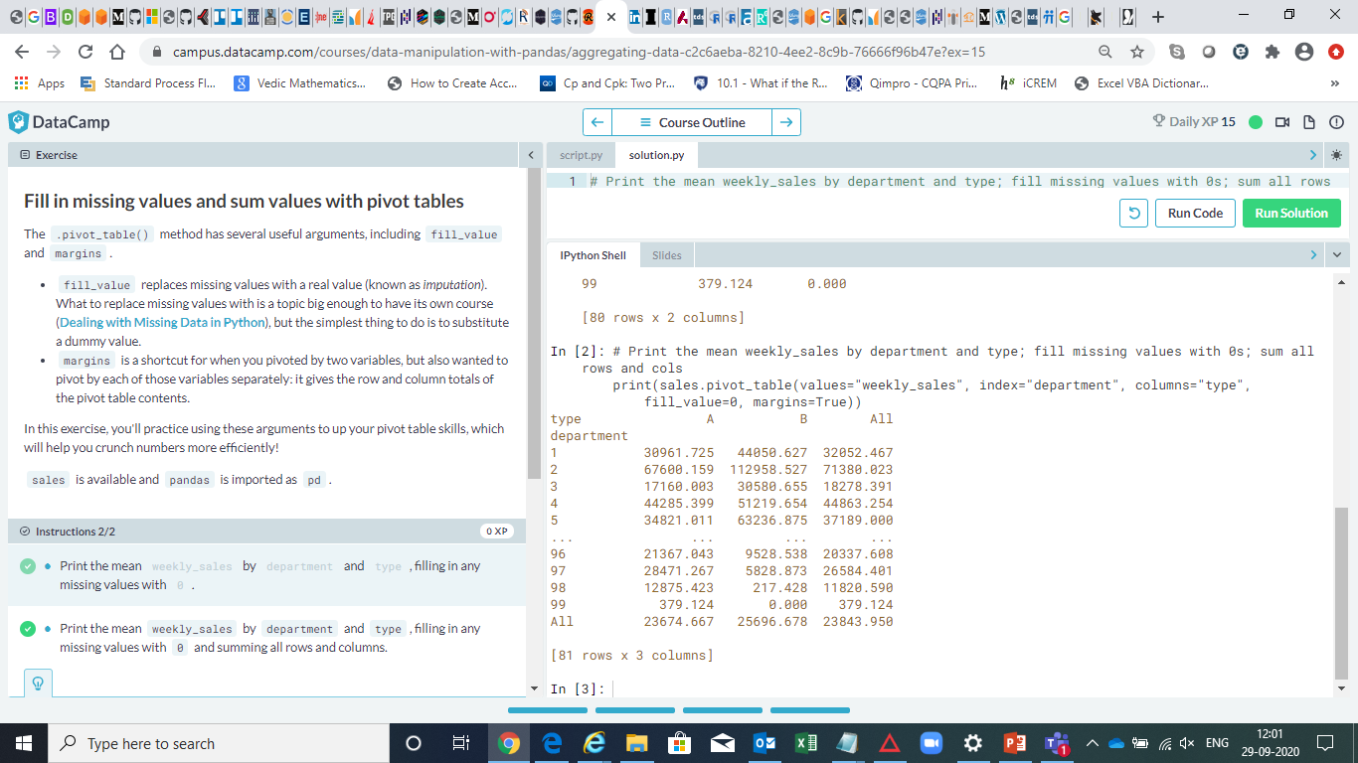

Slide 36
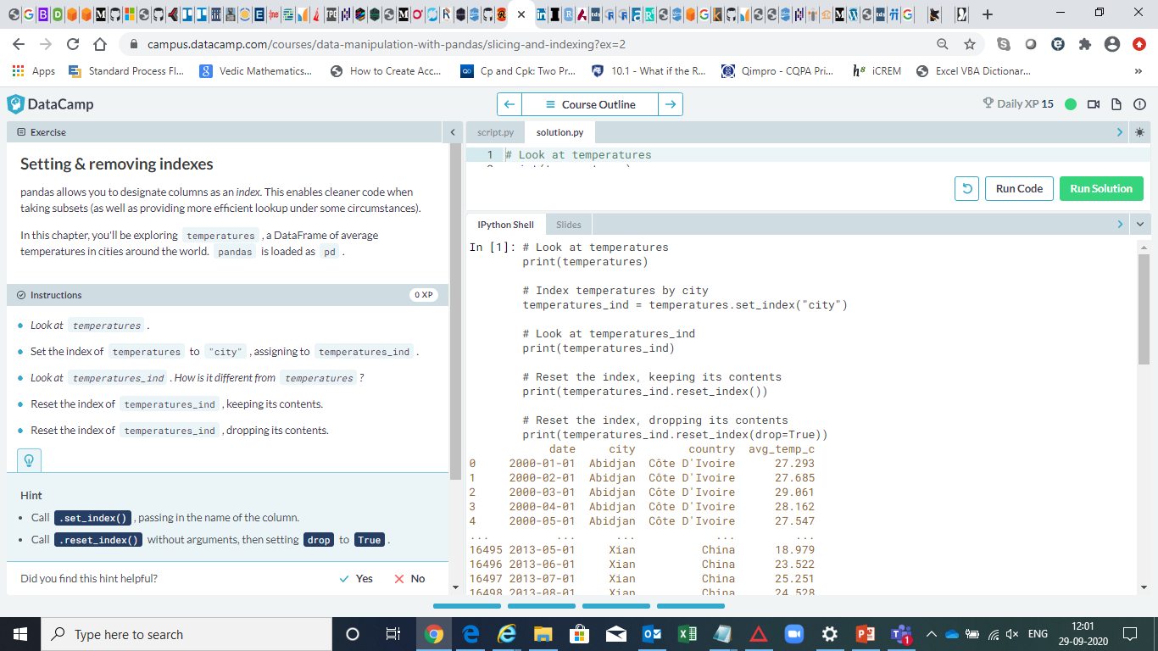

Slide 37
In [1]: # Look at temperatures print(temperatures) # Index temperatures by city temperatures_ind = temperatures.set_index("city") # Look at temperatures_ind print(temperatures_ind) # Reset the index, keeping its contents print(temperatures_ind.reset_index()) # Reset the index, dropping its contents print(temperatures_ind.reset_index(drop=True)) date city country avg_temp_c0 2000-01-01 Abidjan Côte D'Ivoire 27.2931 2000-02-01 Abidjan Côte D'Ivoire 27.6852 2000-03-01 Abidjan Côte D'Ivoire 29.0613 2000-04-01 Abidjan Côte D'Ivoire 28.1624 2000-05-01 Abidjan Côte D'Ivoire 27.547... ... ... ... ...16495 2013-05-01 Xian China 18.97916496 2013-06-01 Xian China 23.52216497 2013-07-01 Xian China 25.25116498 2013-08-01 Xian China 24.52816499 2013-09-01 Xian China NaN[16500 rows x 4 columns] date country avg_temp_ccity Abidjan 2000-01-01 Côte D'Ivoire 27.293Abidjan 2000-02-01 Côte D'Ivoire 27.685Abidjan 2000-03-01 Côte D'Ivoire 29.061Abidjan 2000-04-01 Côte D'Ivoire 28.162Abidjan 2000-05-01 Côte D'Ivoire 27.547... ... ... ...Xian 2013-05-01 China 18.979Xian 2013-06-01 China 23.522Xian 2013-07-01 China 25.251Xian 2013-08-01 China 24.528Xian 2013-09-01 China NaN[16500 rows x 3 columns] city date country avg_temp_c0 Abidjan 2000-01-01 Côte D'Ivoire 27.2931 Abidjan 2000-02-01 Côte D'Ivoire 27.6852 Abidjan 2000-03-01 Côte D'Ivoire 29.0613 Abidjan 2000-04-01 Côte D'Ivoire 28.1624 Abidjan 2000-05-01 Côte D'Ivoire 27.547... ... ... ... ...16495 Xian 2013-05-01 China 18.97916496 Xian 2013-06-01 China 23.52216497 Xian 2013-07-01 China 25.25116498 Xian 2013-08-01 China 24.52816499 Xian 2013-09-01 China NaN[16500 rows x 4 columns] date country avg_temp_c0 2000-01-01 Côte D'Ivoire 27.2931 2000-02-01 Côte D'Ivoire 27.6852 2000-03-01 Côte D'Ivoire 29.0613 2000-04-01 Côte D'Ivoire 28.1624 2000-05-01 Côte D'Ivoire 27.547... ... ... ...16495 2013-05-01 China 18.97916496 2013-06-01 China 23.52216497 2013-07-01 China 25.25116498 2013-08-01 China 24.52816499 2013-09-01 China NaN[16500 rows x 3 columns]In [2]:

Slide 38
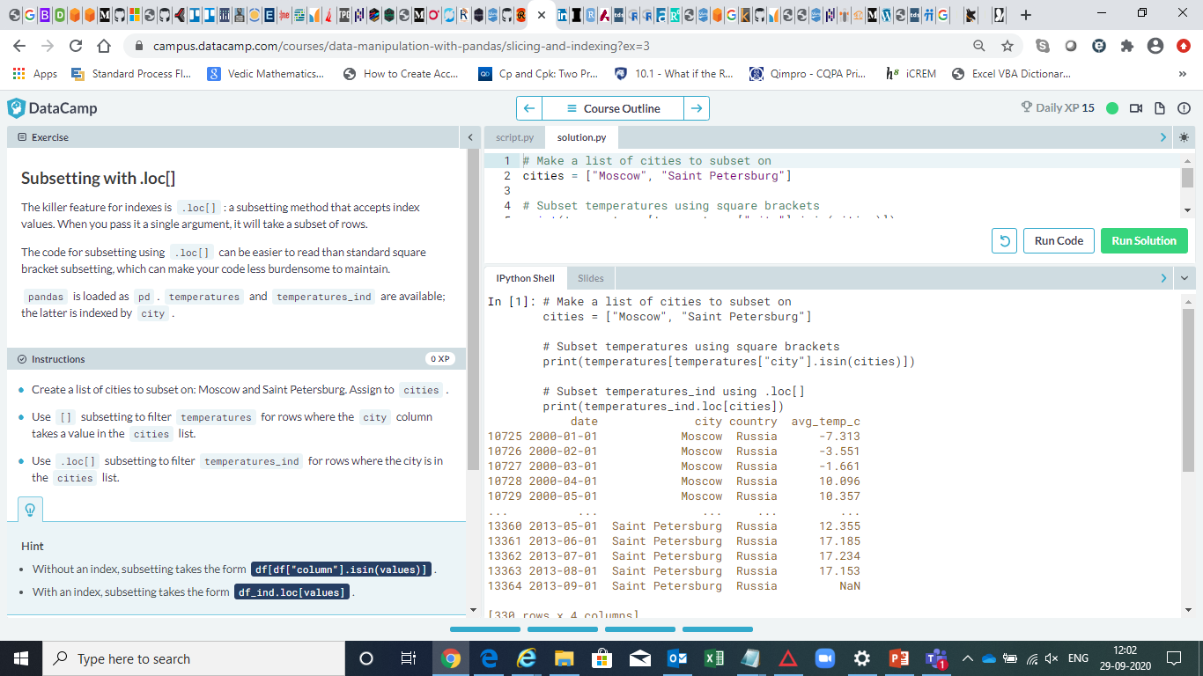

Slide 39
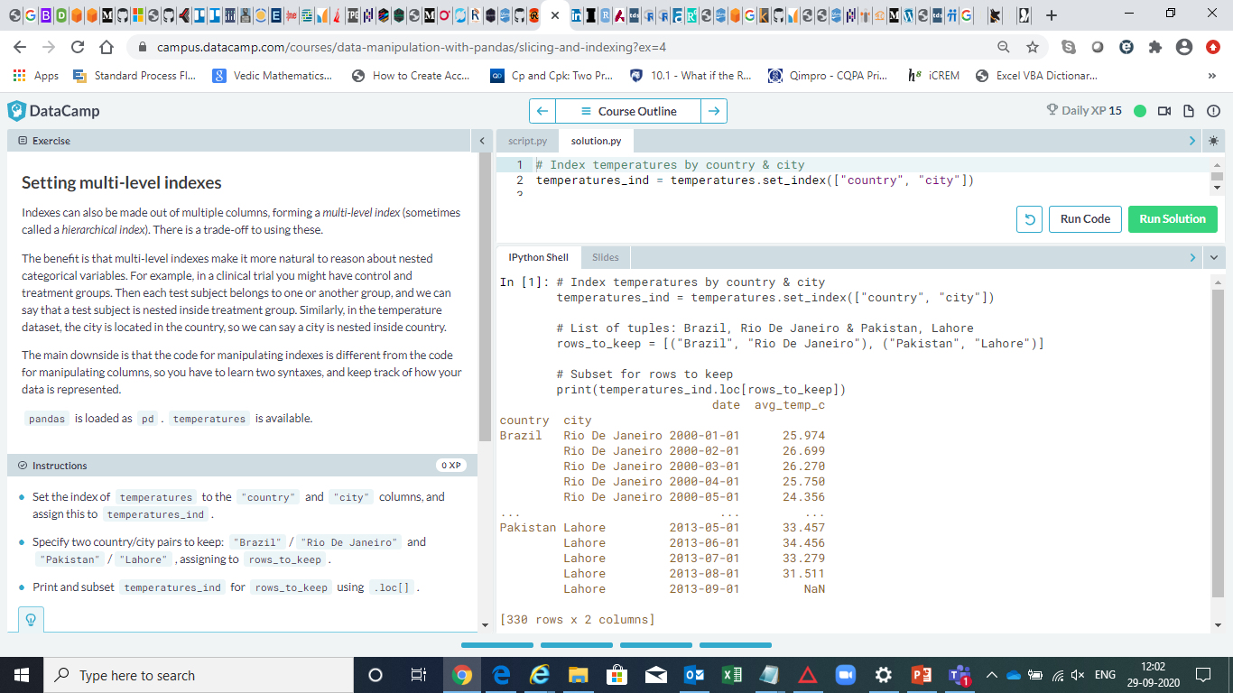

Slide 40
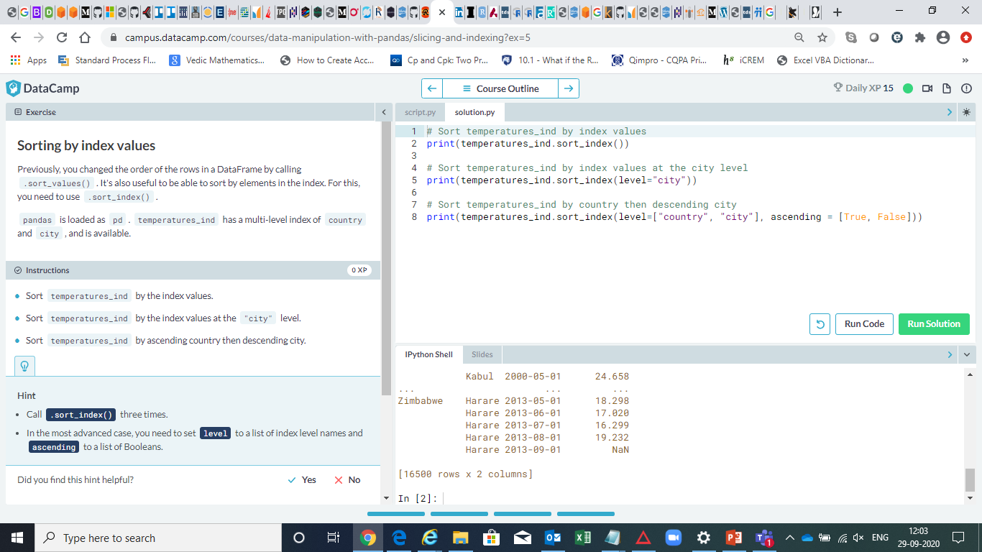

Slide 41
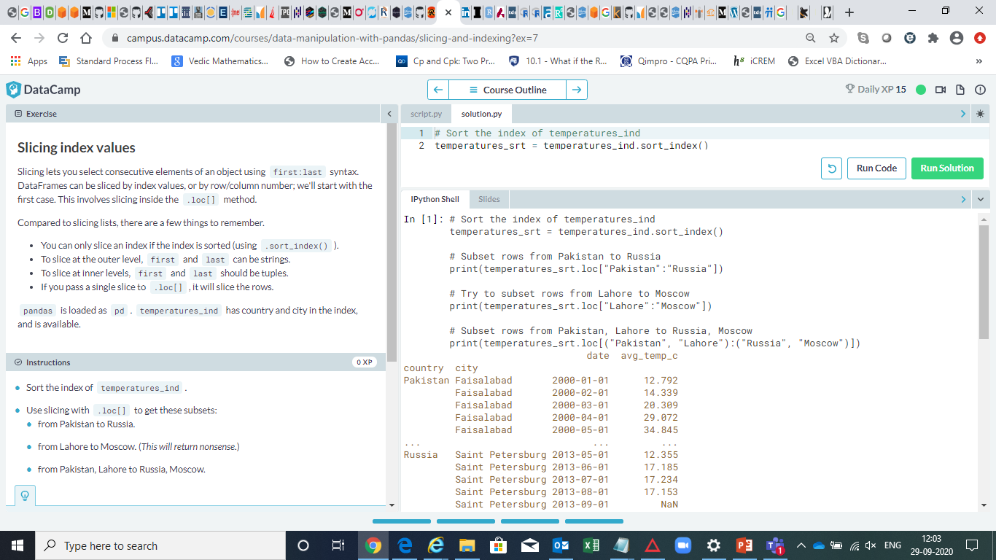

Slide 42
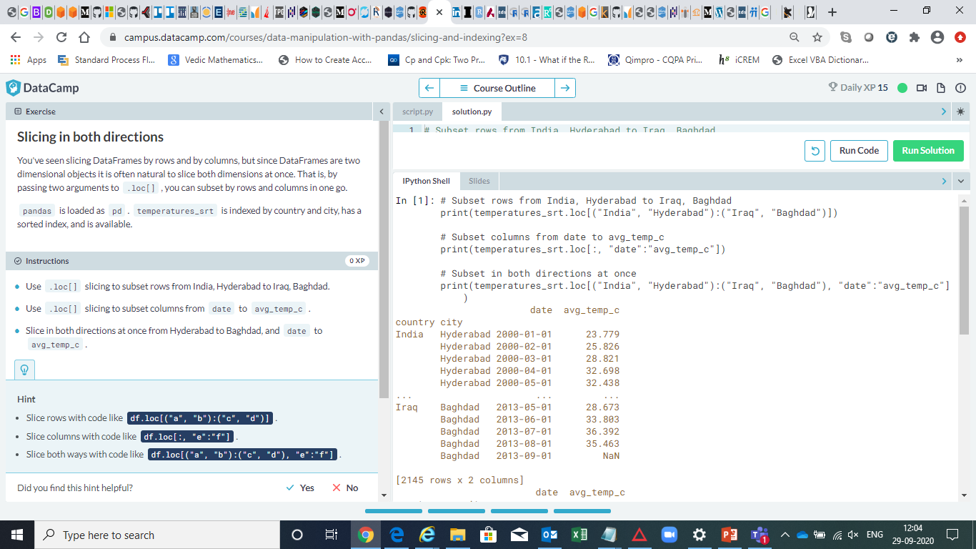

Slide 43
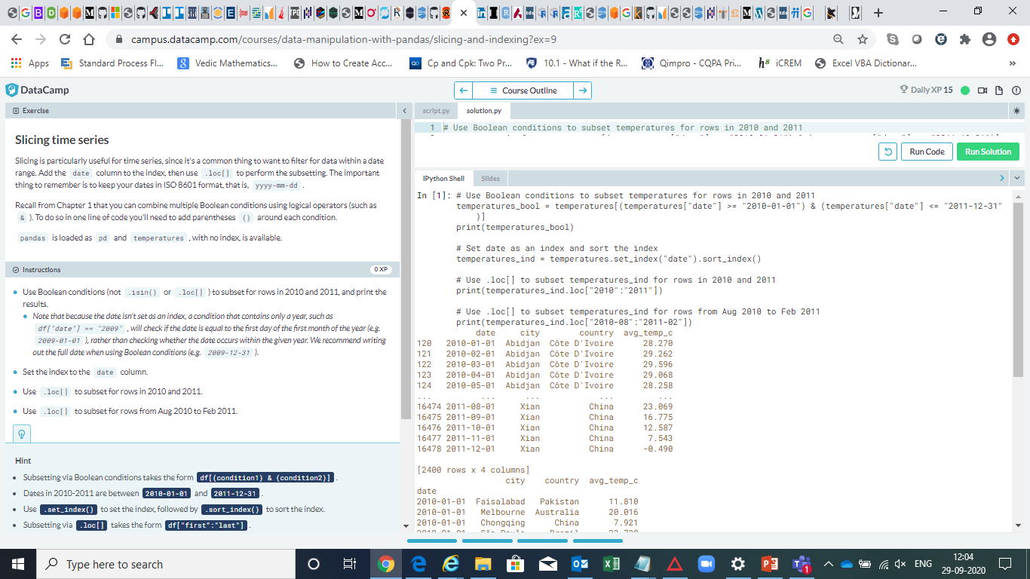

Slide 44
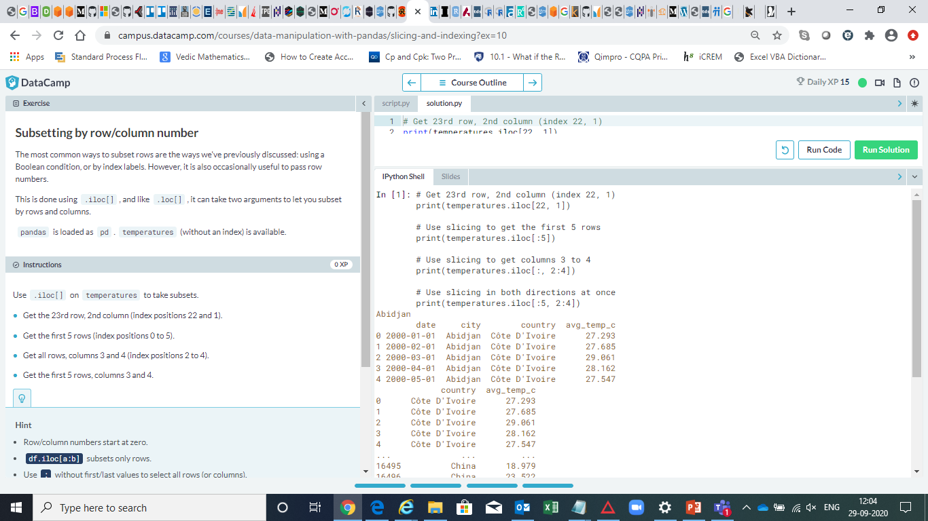

Slide 45
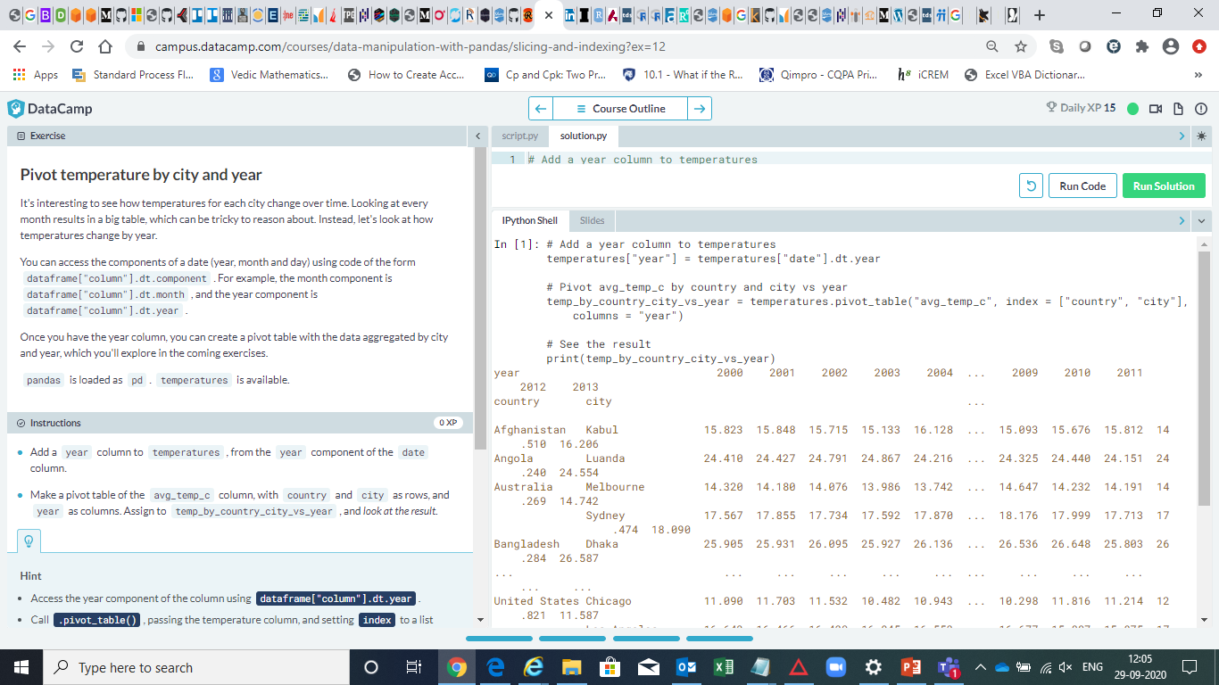

Slide 46
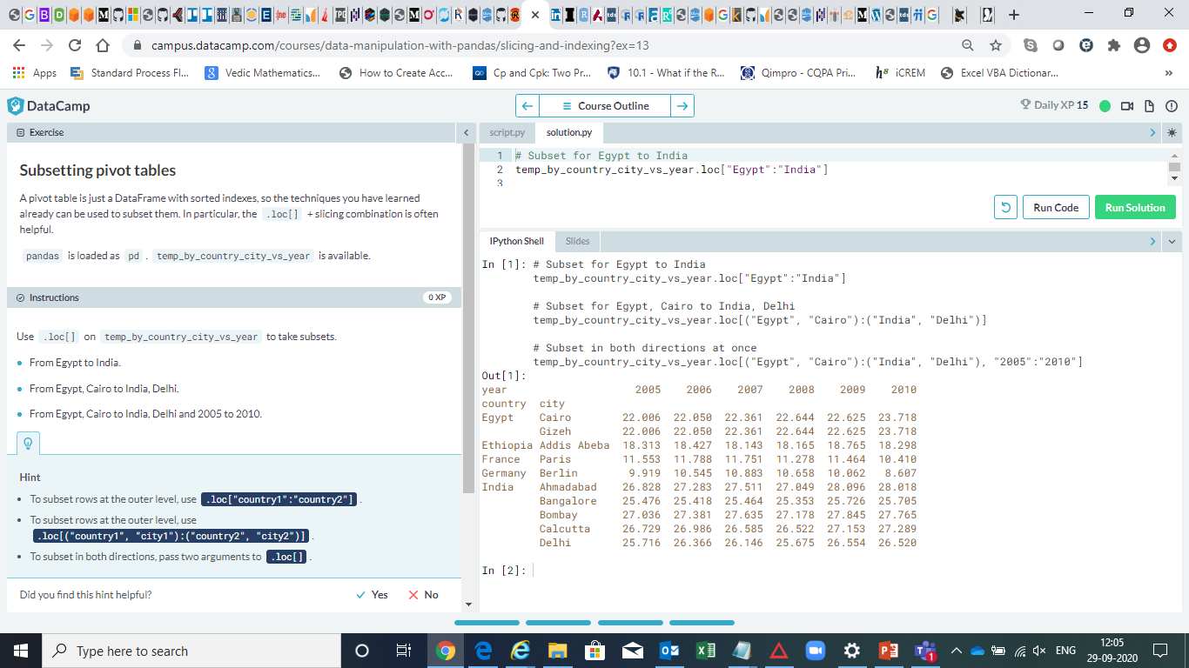

Slide 47
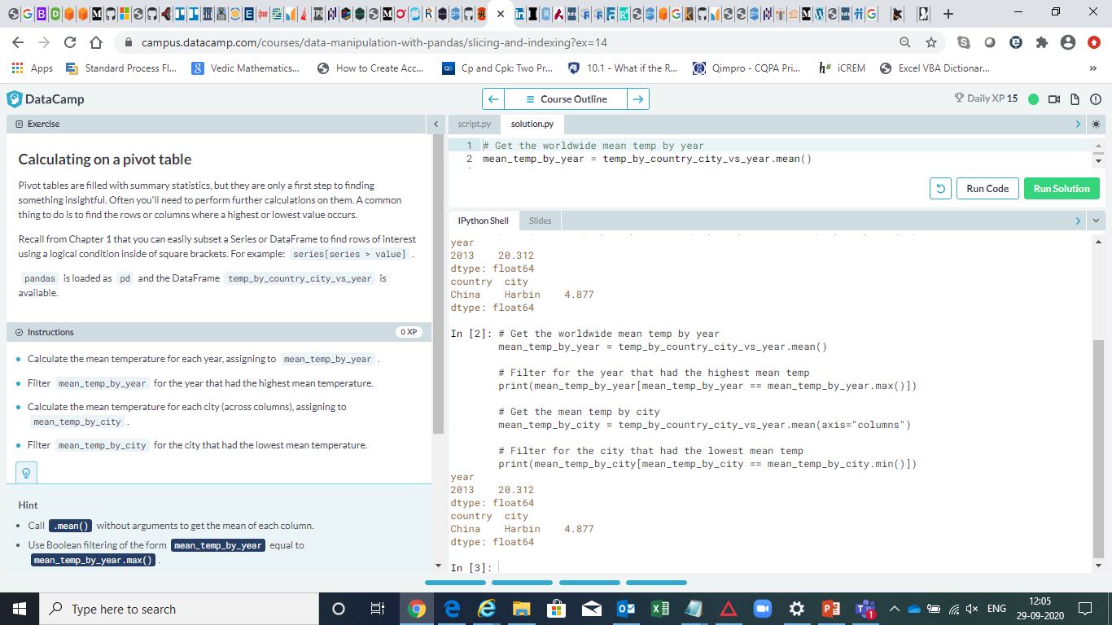

Slide 48
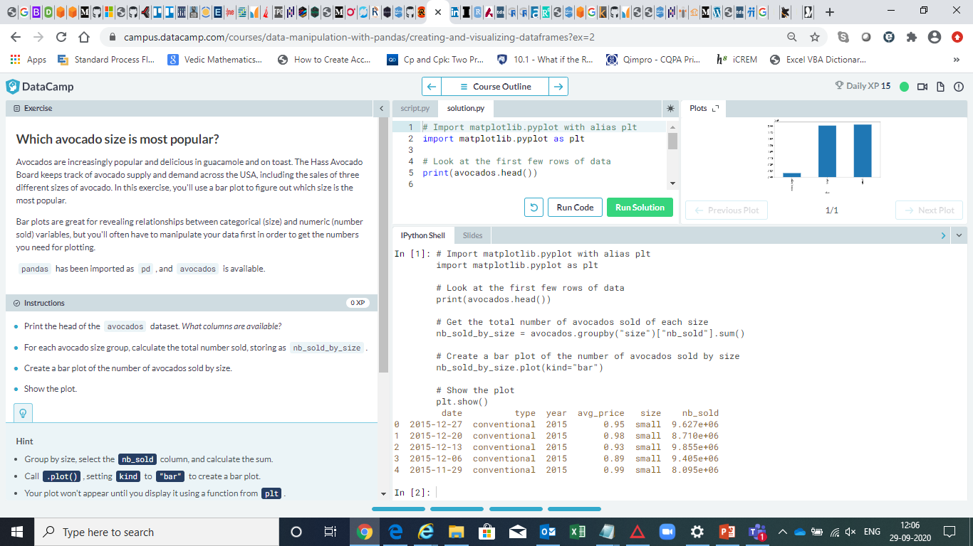

Slide 49
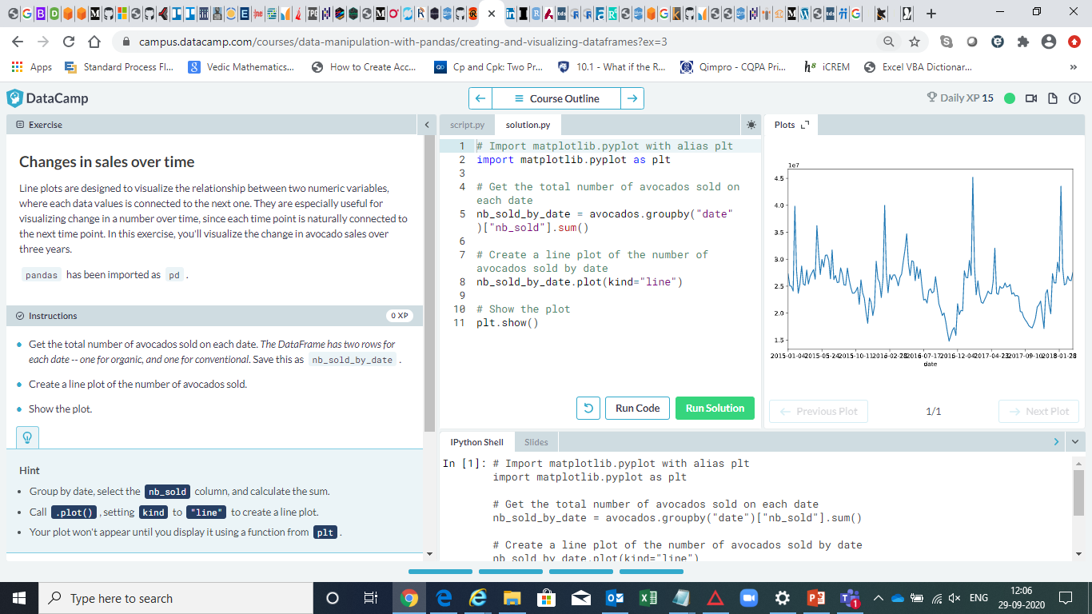

Slide 50
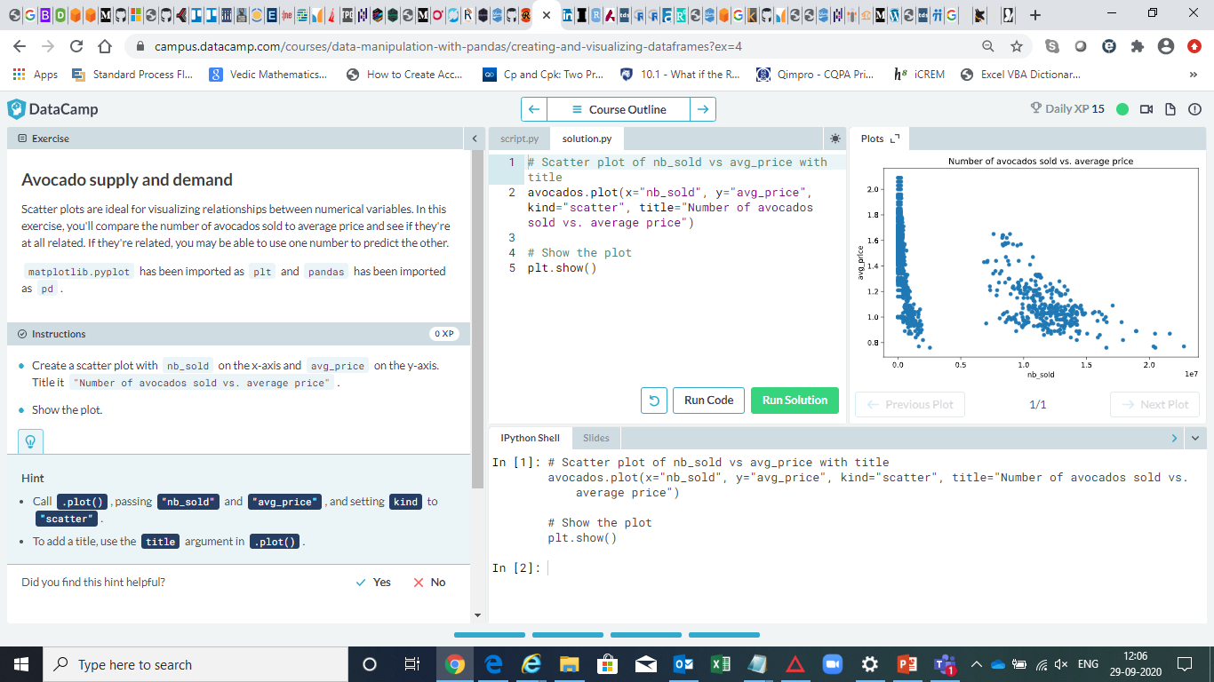

Slide 51
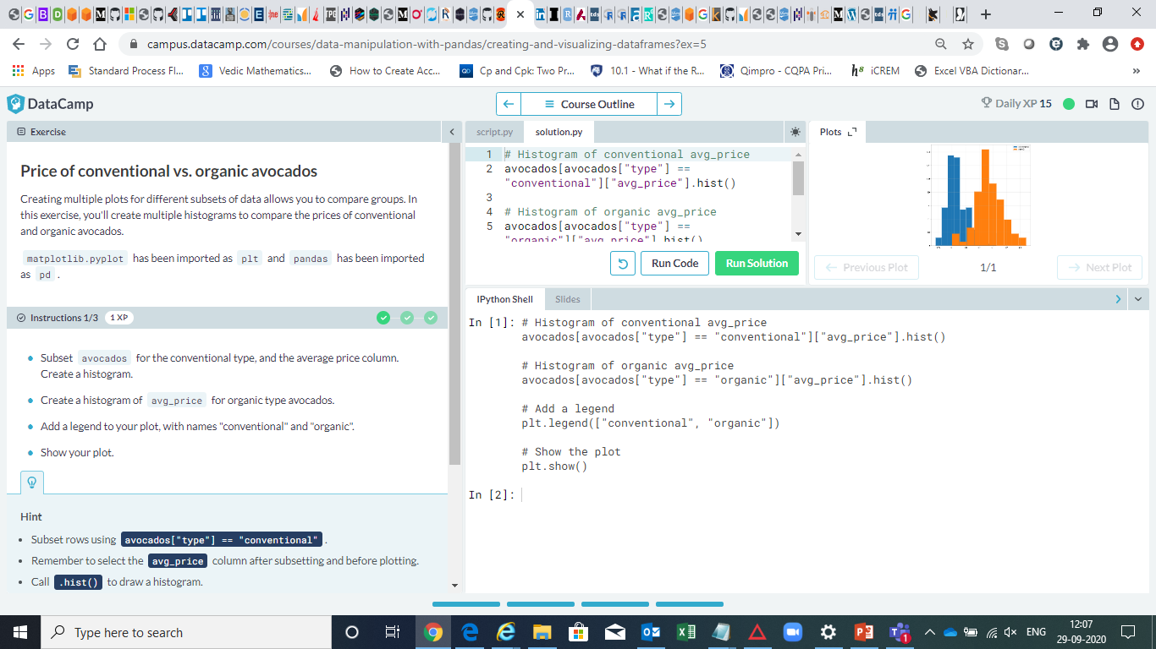

Slide 52
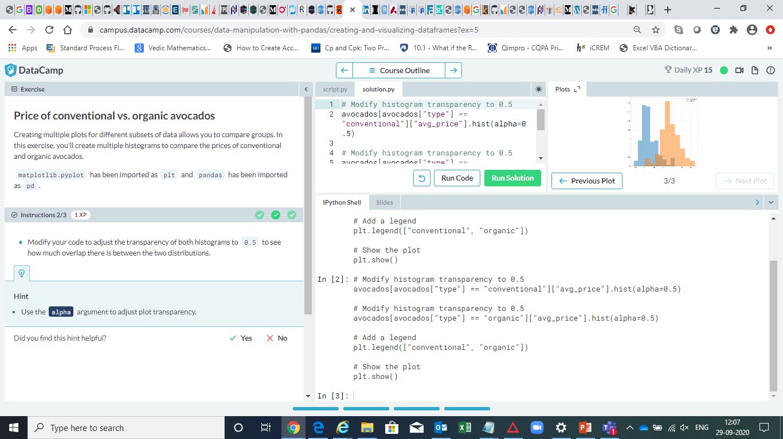

Slide 53
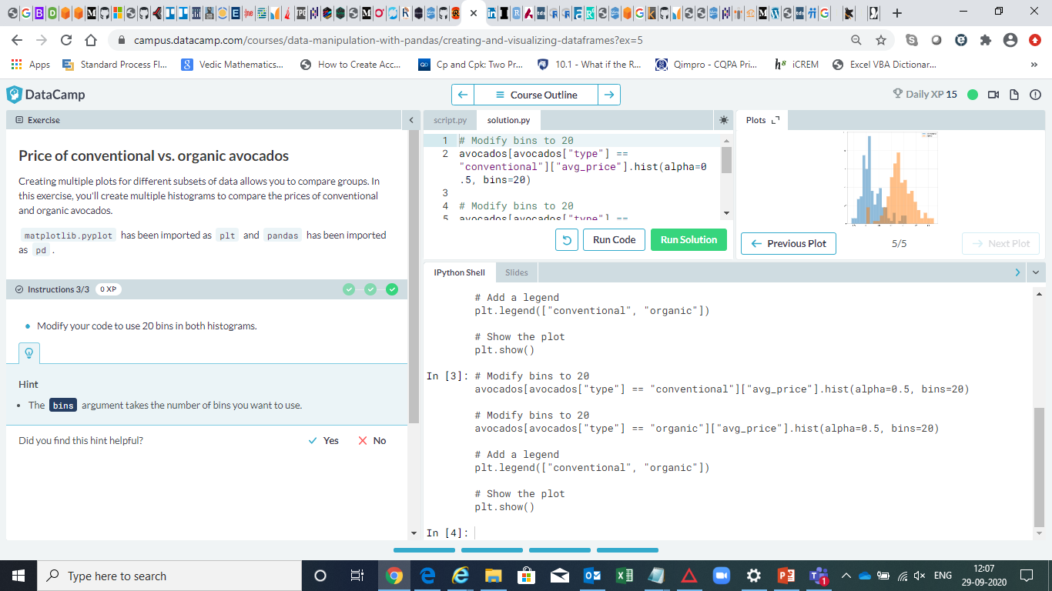

Slide 54
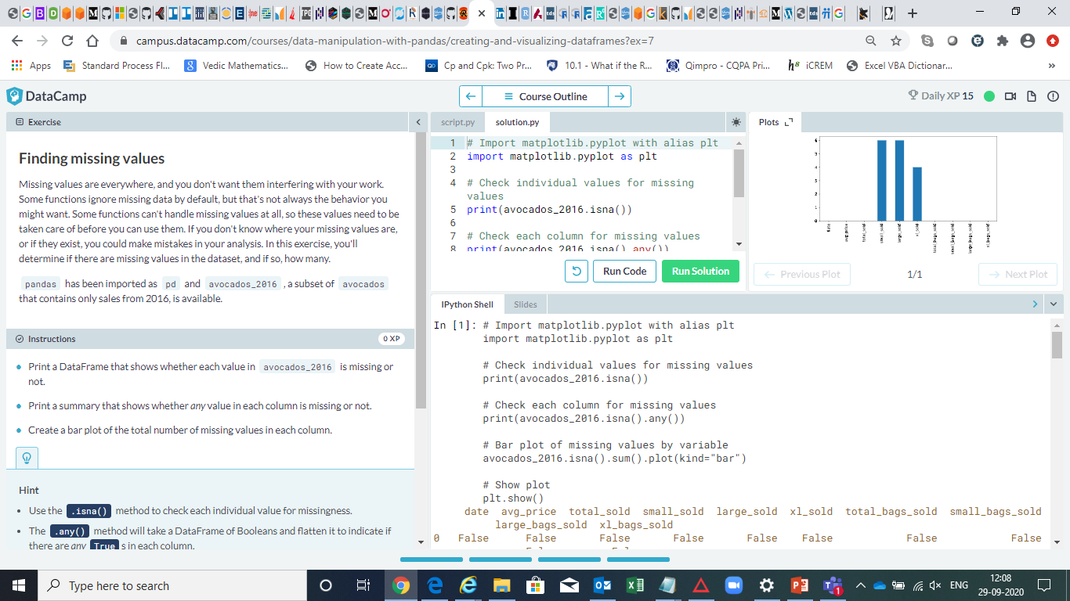

Slide 55
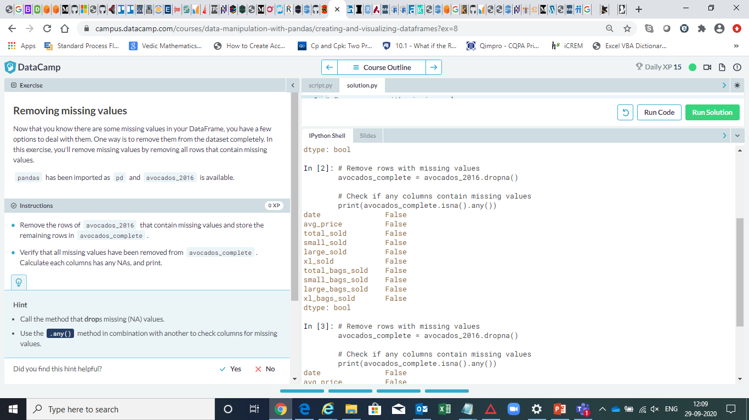

Slide 56
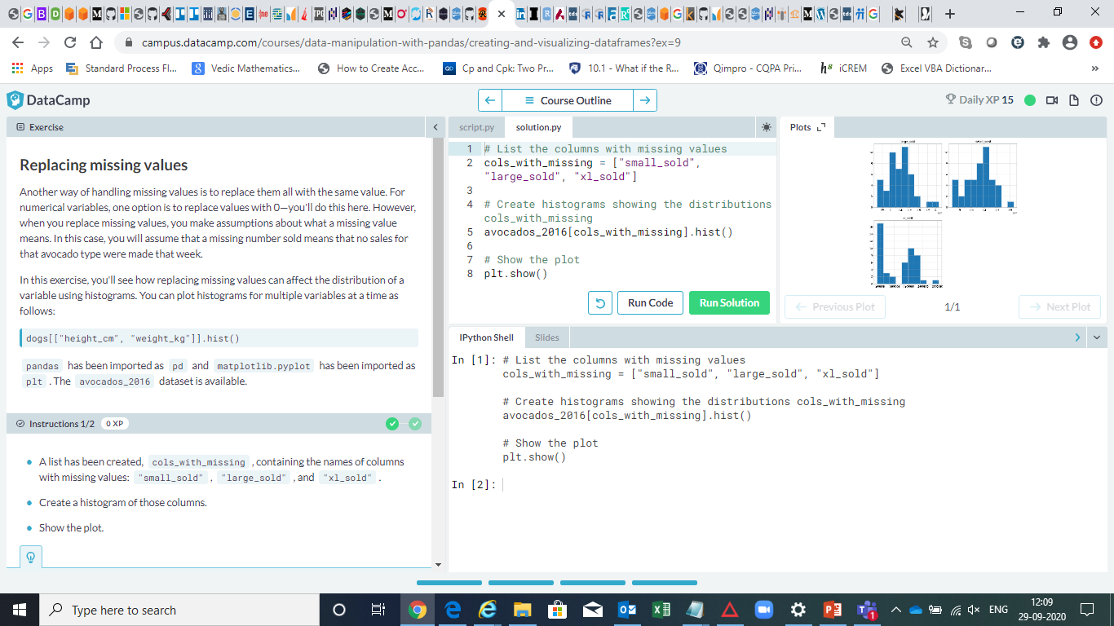

Slide 57


Slide 58


Slide 59


Slide 60


Slide 61


Slide 62


Slide 63


Slide 64


Slide 65


